Slide 1

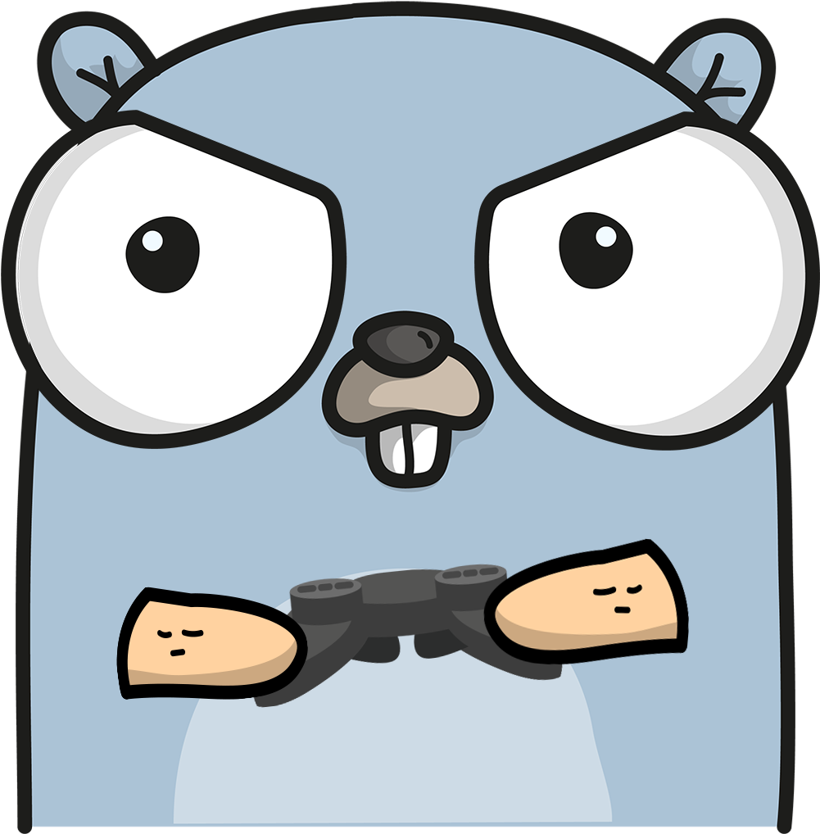
Group 1 Simple Social Media Server
Matt Martin

Slide 2

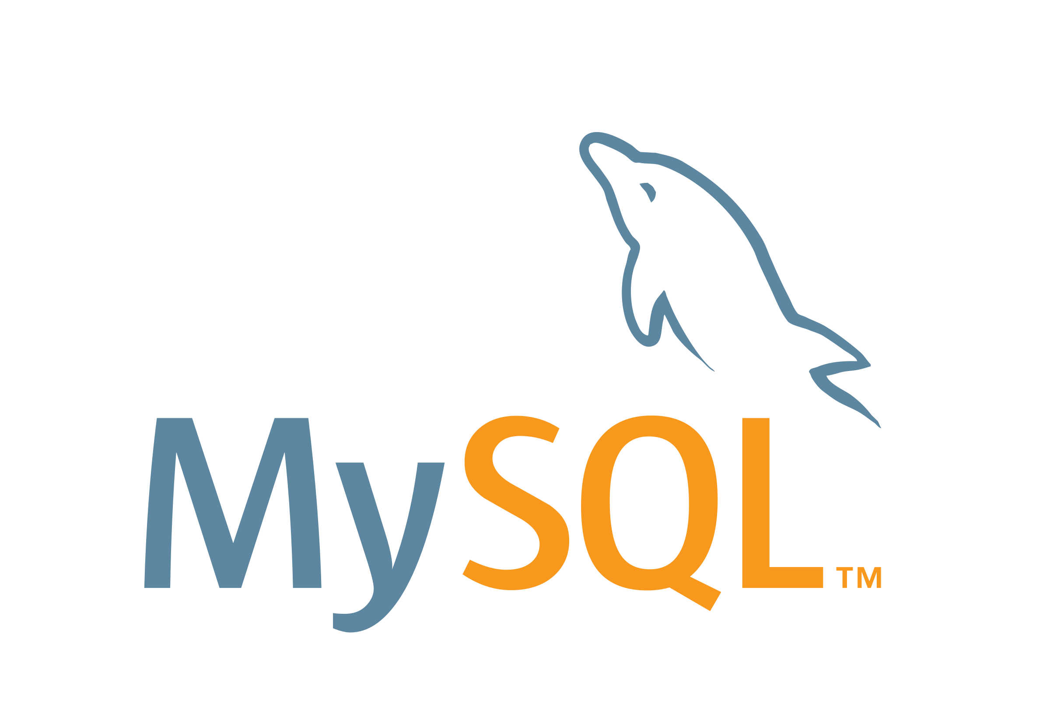


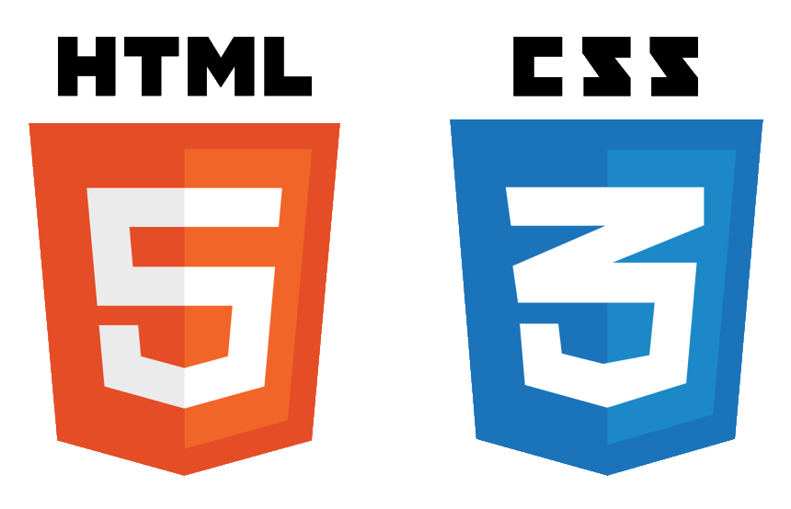
KEY FEATURES
Relational Database
Login/Logout
Profile Information/Update permissions
Post Text
News Feed
User Photo
Other features

Slide 3
Structure
Modules used
Other necessary components
Gorilla/sessions
Database/sql
Go-sql-driver/mysql
MySql 8.0
MySql Workbench
HTML / CSS

Slide 4
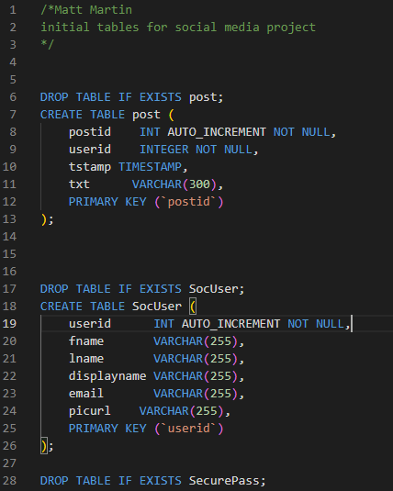

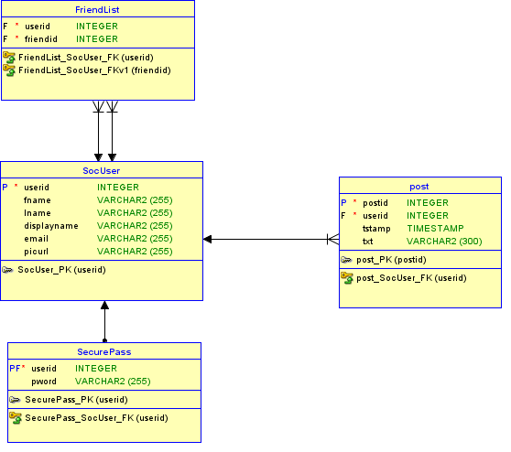

Database creation
Complete the database module
Establish relational database using Data Modeler
Adjust ddl into a more usable sql file to populate initial table
Setup cfg and connect to database from our project

Slide 5
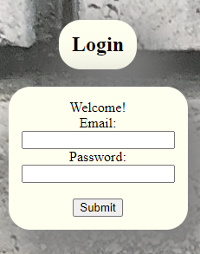
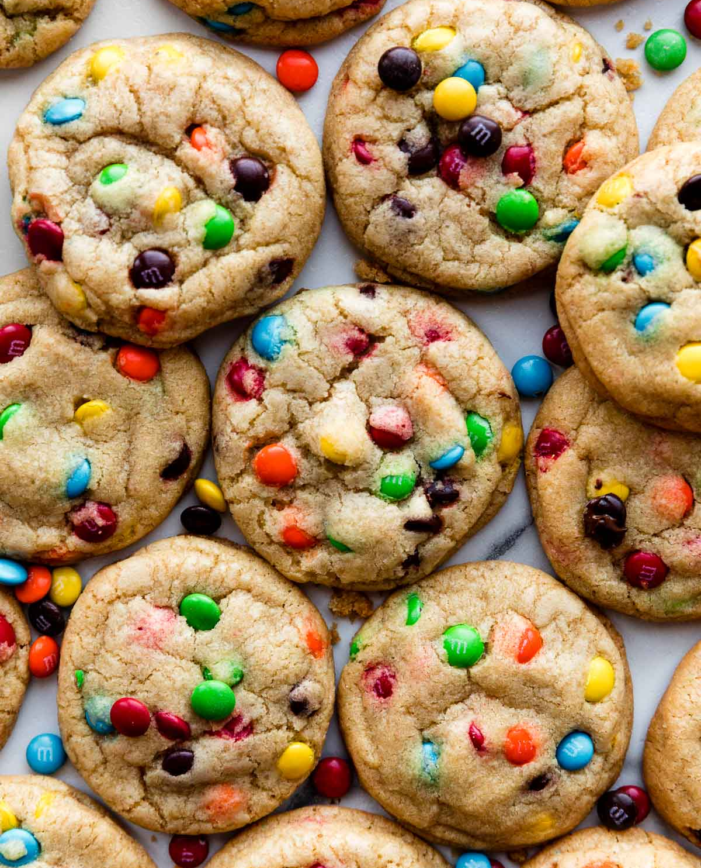
Login/Logout
Handlers:
login
loginHandler
logout
Setup html template
Query database
Issue a cookie
Check for login at the beginning of all necessary handlers. Force a login

Slide 6
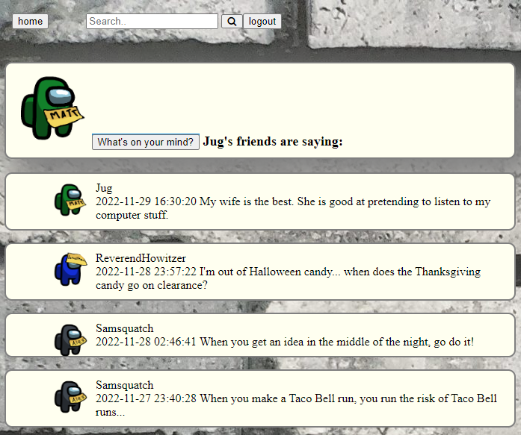
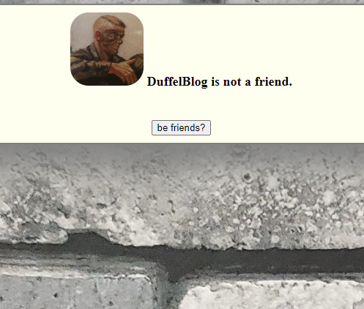
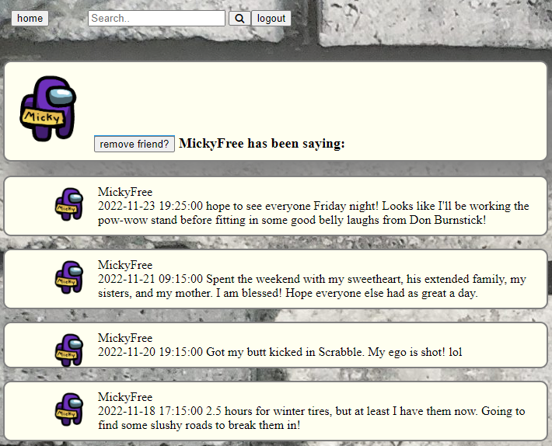
Update permissions
Handlers:
profileView
userView
adjFriend
Not a friend
Is a friend
UserView
Limited view
Information is viewable
Displays all posts from the user and friends newest to oldest

Slide 7
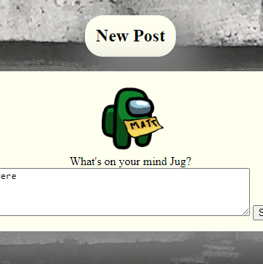
Post Text Interact with the SocMed database post table several ways
Handlers:
profileView
userView
newPost
addPost
Queries for your posts or your friends posts
Create a new post
Insert the new post into the database

Slide 8

News Feed
Reutilizes Profile Template
Presents your data
Presents your friends posts
Handlers:
profileView
userView
allFeed (demonstration only tool)

Slide 9
Update your photo!
Handlers:
newPic
addNewPic
Update the database with a link to a new hosted photo

Slide 10
Other Features
Search bar
Concurrency
Handlers
Allows for searching of other users
If the user is a friend, their posts are displayed
The option to unfriend is also presented
By using a cookie system, multiple users are able to access the web server at the same time.
Different sessions are needed.
profileView for search
Most handlers call for session information to ensure the correct user is being handled

Slide 11
What did I learn?
Setting up a non theoretical database
Crash course in HTML and CSS
Completed posted module 5 steps
Set up MySQL and configured to properly run the project
Deepened understanding of how
Go + a relational database can be a powerful too.
Went from 0 experience in HTML to creating multiple templates with css
Maintained a theme across multiple pages
Presenting data in a consumable format
Deeper understanding of handlers, error checking, templates, parsing etc.
Trial and error
Major rewrites
Backups are your friend. (thank you GitHub!)

Slide 12


Thank You
Matt Martin
matrmart@iu.edu
Files served on domain:
Espinvr.com

